Slide 1
TIDYQUANT
WATCH SHOP ANALYSIS
Jitesh Gupta

Slide 2
SALES ANALYSIS
SALES BY CATEGORY
BASIC
STYLE
OUTDOOR
SPORTS

Slide 3
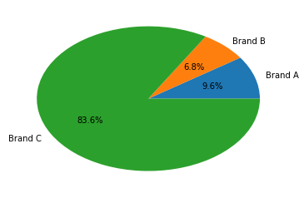
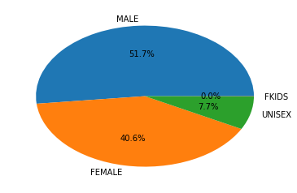
SALES BY BRAND
SALES BY GENDER

Slide 4
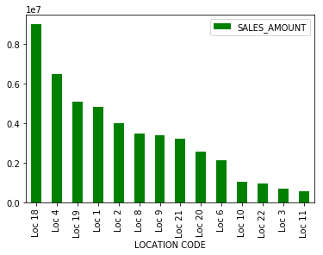
SALES BY LOCATION
Our target customer should be both Males and Females.
Brand C has maximum sales so this brand has good feature and price range.
Location 18,4,19,1 has largest sales .

Slide 5
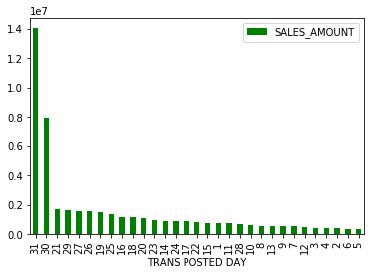
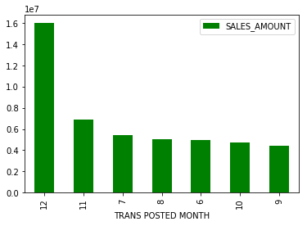
Highest sales are in the month of December,
December is their peak time, other months are constant for sales.
Sales is maximum in December due to New year offer.

Slide 6
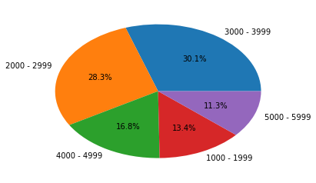
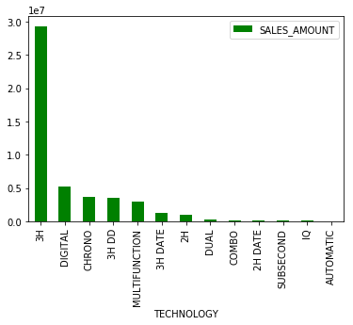
Generally people buys watches in between 2k-3k
Mostly, People prefer 3H technology watches in between 3k – 4k

Slide 7
BRAND
BRAND A
ENTRY PRICE
LADIES DRESS
BRAND C
BASIC
BRAND B
STYLE
SPORTS
URBAN STYLE
SMART STYLE

Slide 8
BRAND A
ENTRY PRICE
CASE MATERIAL = SS
CASE SHAPE = ROUND
SILVER = 137
GOLDEN = 222
CASE MATERIAL=SS
LADIES DRESS
SILVER =256
GOLDEN = 231
DIAL = ANALOG
STRAP = SS
PRICE RANGE = 1K-3K
TECHNOLOGY = 3H
CASE SHAPE = ROUND
STRAP = SS
DIAL = ANALOG
TECHNOLOGY = 3 H
PRICE RANGE =2K-4K

Slide 9
BRAND A
BRAND A sales of both categories are approximately equal.
LADIES DRESS brand watches are more expensive
LADIES PRICE brand is only for ladies.
ENTRY PRICE brand is for both
To increase their sales they have to focus on both males and females and location.
They have maintain the latest technology which is good for them

Slide 10
BRAND B
URABAN STYLE
CASE MATERIAL = SS, ALLOY
CASE SHAPE = ROUND, RECTANGLE
SILVER = 120
BLK = 62
CASE MATERIAL=SS
SMART STYLE
SILVER =111
BLK = 57
DIAL = ANALOG
STRAP = SS, LEATHER
PRICE RANGE = 6K-9K
TECHNOLOGY = MULTIFUNCTION
CASE SHAPE = ROUND
STRAP = SS, LEATHER
DIAL = ANALOG
TECHNOLOGY = 3H DATE, MULTIFUNCTION
PRICE RANGE =5K-6K
DIAL COLOUR = BLACK, SILVER
DIAL COLOUR = BLACK, SILVER

Slide 11
BRAND B
Sales of URBAN STYLE brand is greater than SMART STYLE brand.
URBAN STYLE watches are more expensive than SMART STYLE watches.
URBAN STYLE and SMART STYLE are only for males.
I think to increase their sales they have to focus on both males and females and location of watches is also a main factor for sales.
They have to maintain MULTIFUNCTION Technology as well as they have to take new technology like 3H, 3H-Date.

Slide 12
BRAND C
BASIC
CASE MATERIAL = BRASS
CASE SHAPE = ROUND
SILVER = 1204
BLK = 1184
CASE MATERIAL= BRASS
STYLE
GOLDEN =3653
SILVER = 1700
DIAL = ANALOG
STRAP = SS > LEATHER
PRICE RANGE = 2K-6K
TECHNOLOGY = 3H
CASE SHAPE = ROUND
STRAP = SS > LEATHER
DIAL = ANALOG
TECHNOLOGY = 3H
PRICE RANGE =3K-6K
DIAL COLOUR = WHITE, CHMP
DIAL COLOUR = WHITE
STRAP COLOUR = GOLDEN, SILVER
STRAP COLOUR = BROWN, SILVER
CASE MATERIAL = RESIN
SPORTS
BLACK = 357
SILVER = 176
CASE SHAPE = ROUND
DIAL = DIGITAL
TECHNOLOGY = DIGITAL
DIAL COLOUR= NORMAL
STRAP = RESIN
STRAP COLOUR =BLACK , WHITE
PRICE RANGE =0K-3K

Slide 13
BRAND C
Sales BASIC > STYLE > SPORTS
BASIC style has more choices in 2k-6k range while STYLE has choices in 3k- 6k range, SPORTS in 0k-3k.
Majority of watches in BASIC AND STYLE categories are for females only , while SPORTS watches are for both males and females.
They are updated with latest technology= 3 H, and majority range is 2k-3k there for there sales are Good with respect to other brands.

Slide 14
MARKETING STRETEGY
TECHNOLOGY = 3 H
CASE MATERIAL = Golden
CASE SHAPE = Round
DIAL COLOUR = White
LOCATION = LOC 18 > LOC 4 > LOC 19 > LOC 1
STRAP COLOUR = Silver, Golden , Brown
Males > Females
Price range = 2k-4k
These are the key factor of its increasing sales, Males prefer watches more then females . They are quit comfortable in between 2k-4k,location is must be good, generally everyone prefer round shape over other.

Slide 15
THANKS FOR THE
OPPORTUNITY

